Slide 1
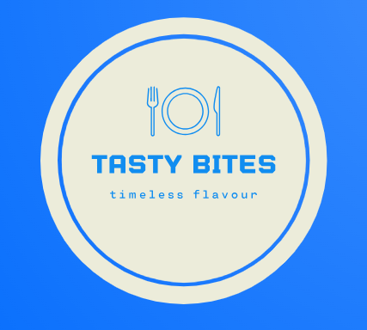
Tasty Bites Business Analytics Report
Presented by: Raymond

Slide 2
Company Overview
Tasty Bites is a small but growing restaurant located in Accra.
Sales and customer visits have been in inconsistent in the past 4 months.
Objectives
What days are busiest?
How do promotions impact sales?
What weather conditions impact the business?
Which dishes are most popular?
How does customer feedback relate to sales?

Slide 3
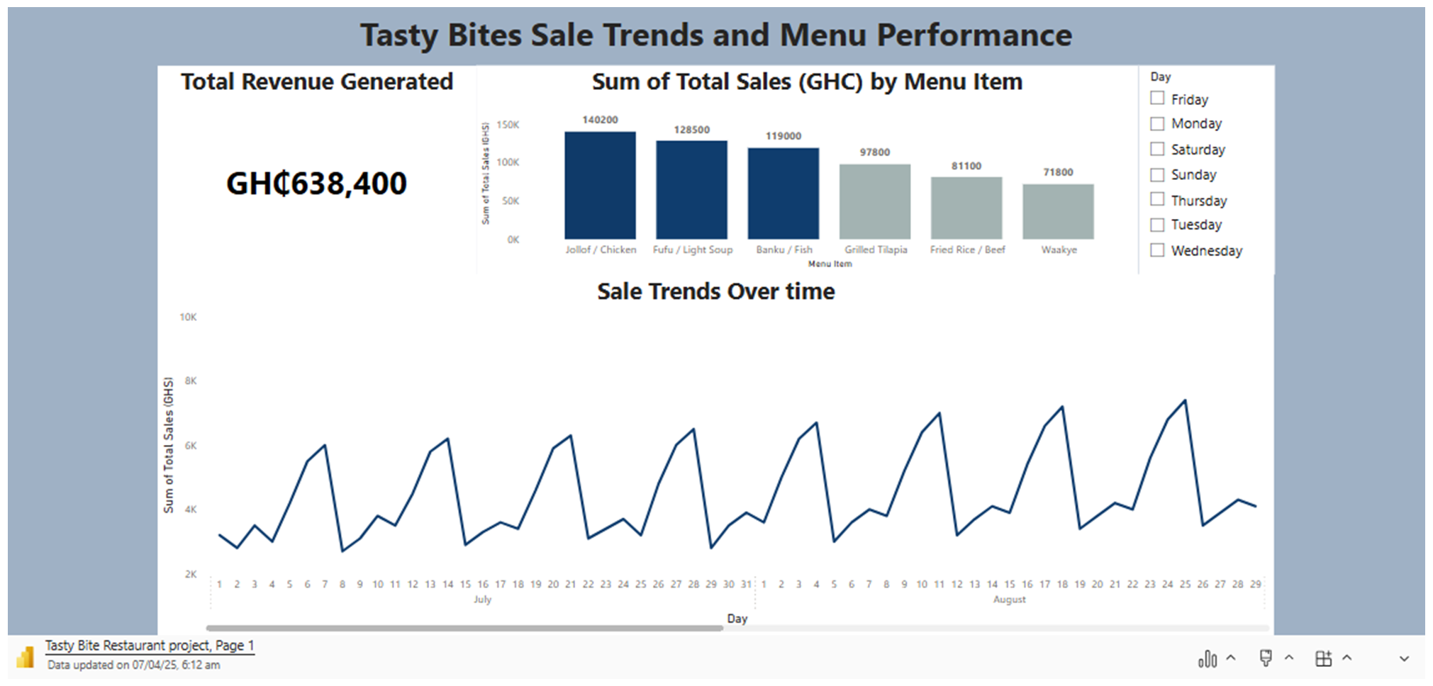

Slide 4
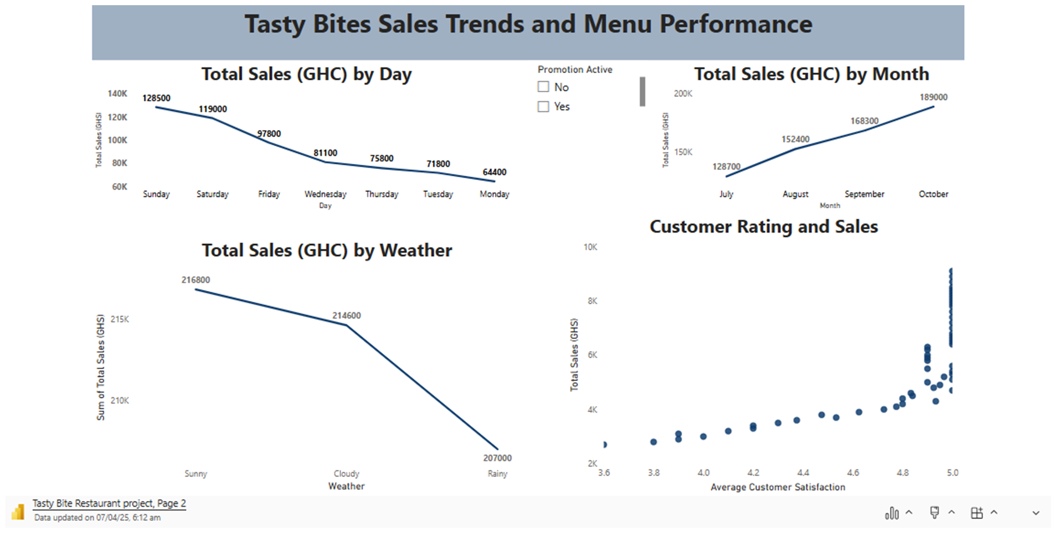

Slide 5
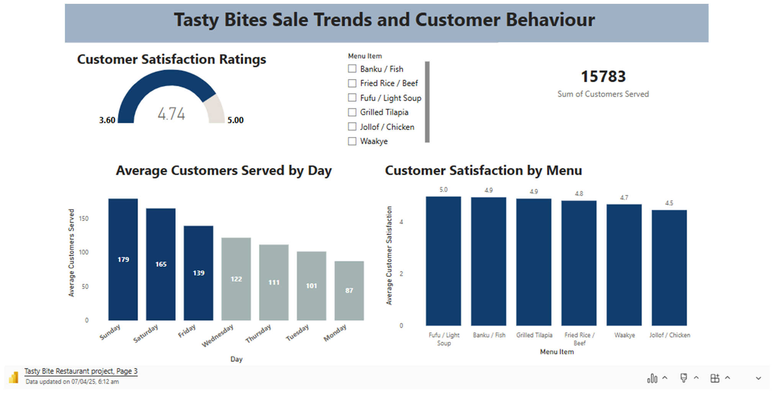

Slide 6
Business Recommendation for Tasty Bites
Designed targeted promotions on weekdays
Introduce delivery services
Entertainment activities
Increase publicity for Tasty Bites through Social Media and other advertising platforms

Slide 7


